Slide 1
CHINOOK MUSIC DATASET ANALYSIS
By
M.V.S. Vamsi krishna

Slide 2
Table of contents
Problem Statement
Data description
Database Schema
Key insights and their visualizations
Strategies to Maximize Store Profits
Conclusion

Slide 3
Problem statement
You are hired as a data analyst at Chinook, and your objective is to analyze music record sales data to gain insights and make recommendations for the company's strategy in the physical music market.

Slide 4
Data description:
This database is designed for managing a music store's operations, including customer purchases, music inventory, and employee records. Below is a brief summary of the key tables and their purposes:
Employee: Stores employee details like names, roles, and reporting hierarchy.
Customer: Contains customer information, including invoices, contact details and support representatives.
Invoice: Tracks transactions of customers with billing information and total amounts.
Invoice Line: Details items purchased in each invoice, including track, quantity, and price.

Slide 5
Data description:
Track: Stores details of individual music tracks, including album, genre, and media type.
Album and Artist: Contains information about music albums and their associated artists.
Playlist: Lists user-generated playlists and the tracks they include.
Media Type: Defines the formats (e.g., MP3, WAV) of music tracks.
Genre: Categorizes tracks into genres like Rock, Jazz, etc.

Slide 6
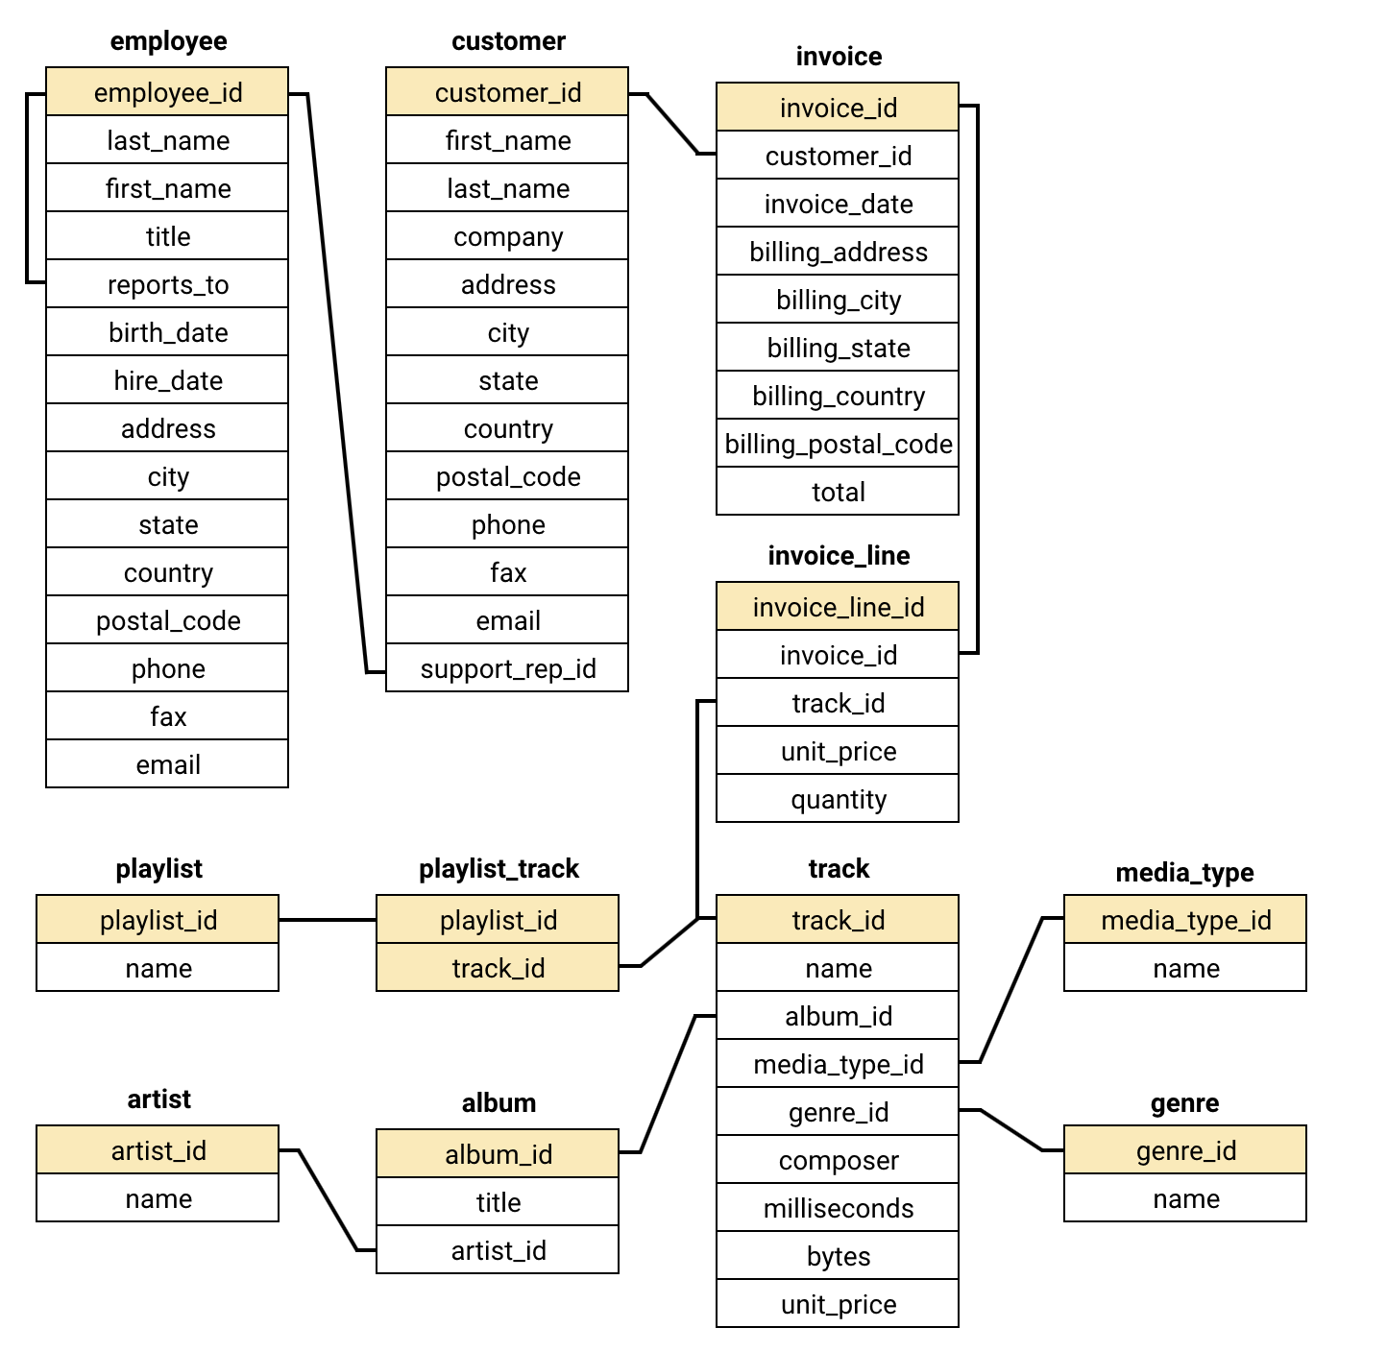
Database Schema :

Slide 7
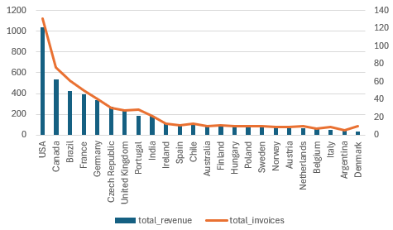
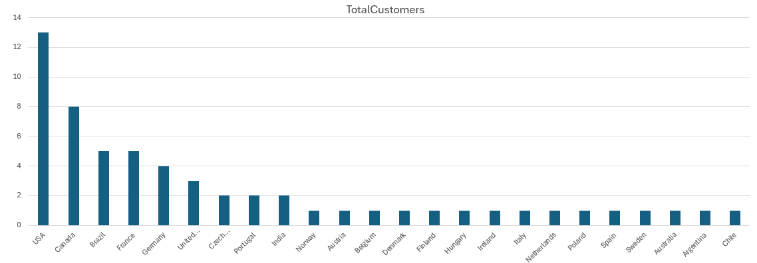
Key insights and their visualizations
USA generates the highest revenue and gets highest number of invoices followed by Canada and Brazil.
USA is the country where most of the customers are located followed by Canada, Brazil and France.

Slide 8
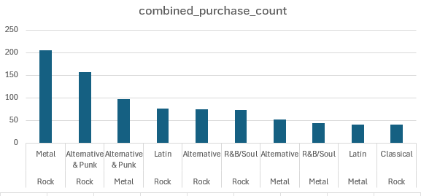
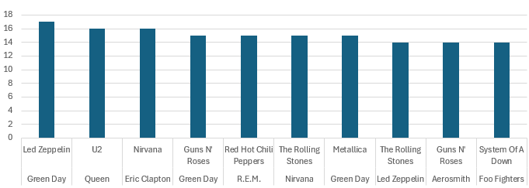
Rock and Metal are the genres which are sold together the most.
Led Zeppelin and Green Day are the artist are sold together the highest.

Slide 9
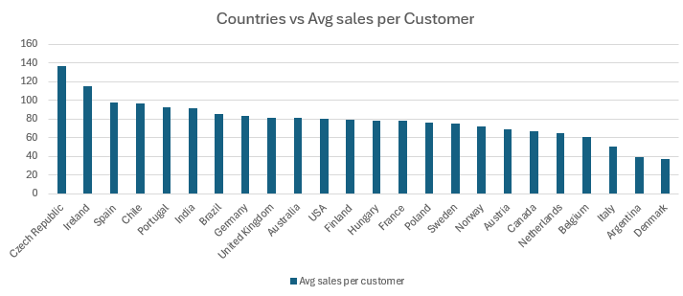
USA, Canada and Brazil are the top 3 countries with the highest average spending customer base.

Slide 10
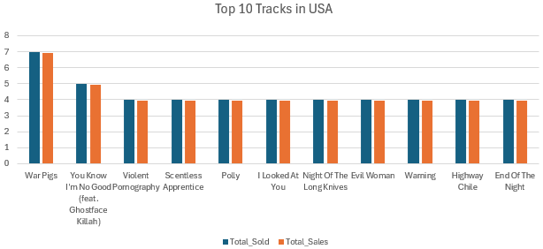
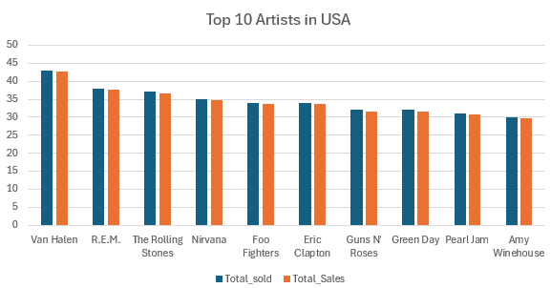
War Pigs is the most famous Track in USA followed by You know I’m no good.
Van Malen is the most popular Artist in USA followed by R.E.M and The Rolling Stone

Slide 11
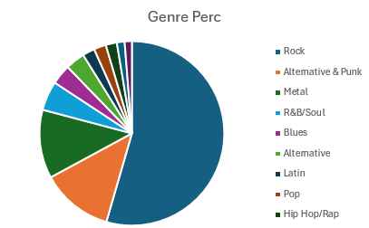
Below Pie Chart shows Top 8 Genres in USA based on their Sales performance.
And Rock, Alternative & Punk and Metal covers more than 75% of sales in the store.

Slide 12
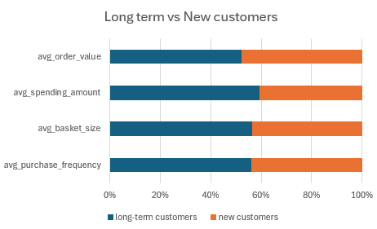
Below stacked bar shows Long-term customers vs New customers in various metrics like average purchase frequency, basket size, spending amount, and order value.
We can see higher loyalty and spending tendencies among long-term customers. And it also emphasizing the need for retention strategies towards New customers.

Slide 13
Strategies to Maximize Store Profits
To enhance sales, high-affinity genres, tracks, and artists should be bundled and promoted together through combination deals.
The top-performing artist is Van Halen, and the United States holds the largest customer base.
Loyal and long-term customers show a trend of frequent purchases and higher spending, reflecting strong customer engagement.
While Rock music leads in popularity worldwide, regional preferences vary, such as Brazil favoring Alternative & Punk and Metal genres.
Additionally, collecting feedback from regions with lower-value customers can help tailor strategies to increase their engagement and expand the overall user base.

Slide 14
Conclusion :
To maximize engagement, pair high-affinity genres, tracks, and artists in promotional offers and bundled sales.
Add tracks from low-selling albums to curated playlists to increase their visibility and appeal.
Introduce a subscription model with exclusive perks and discounts to enhance customer loyalty and boost revenue.
Additionally, sponsor collaborative concerts featuring popular artists to expand brand visibility and elevate brand perception.
Collect feedback from regions with lower-value customers to identify opportunities for converting them into higher-value segments and growing the customer base.

Slide 15
- Thank You

